Slide 1
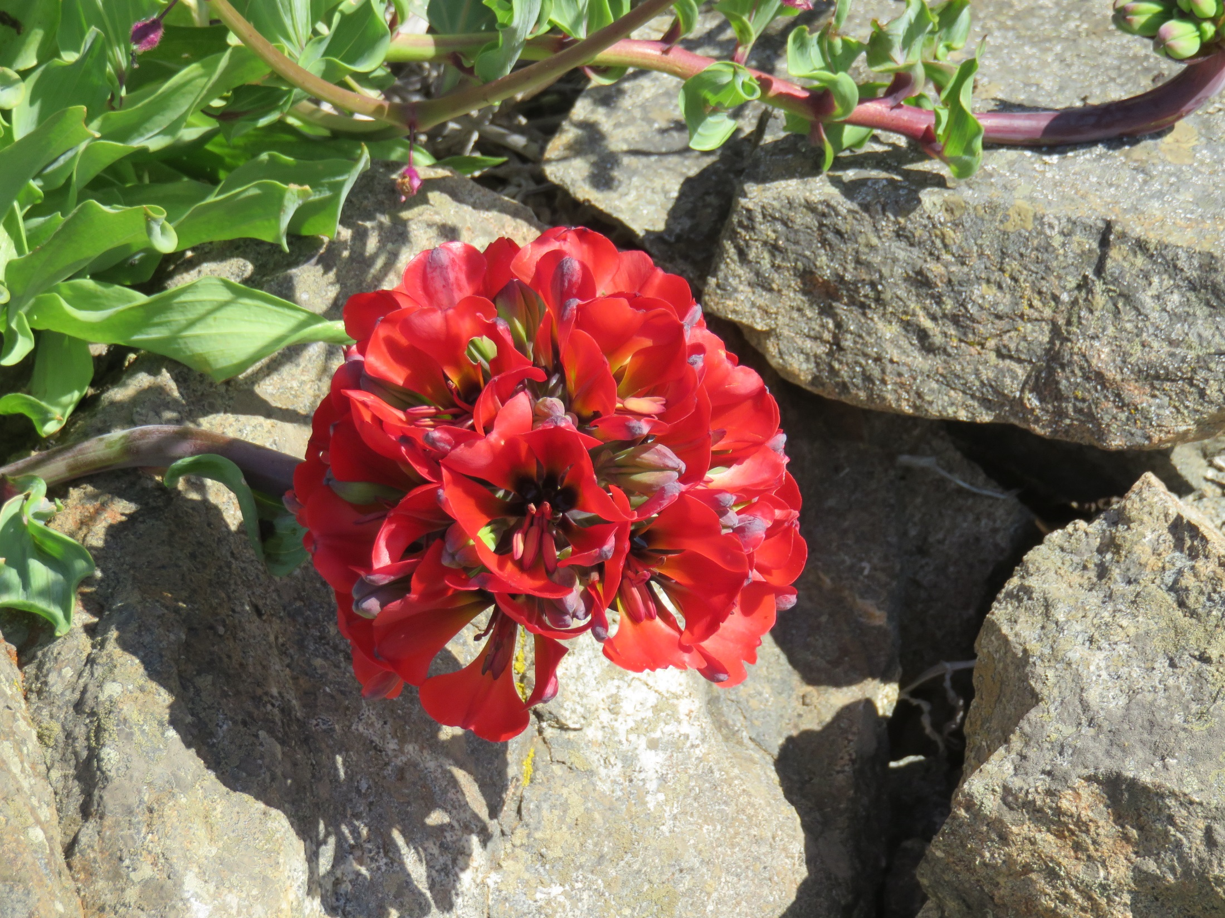
The Garra de Leon (Lion’s claw) flowers only rarely

Slide 2
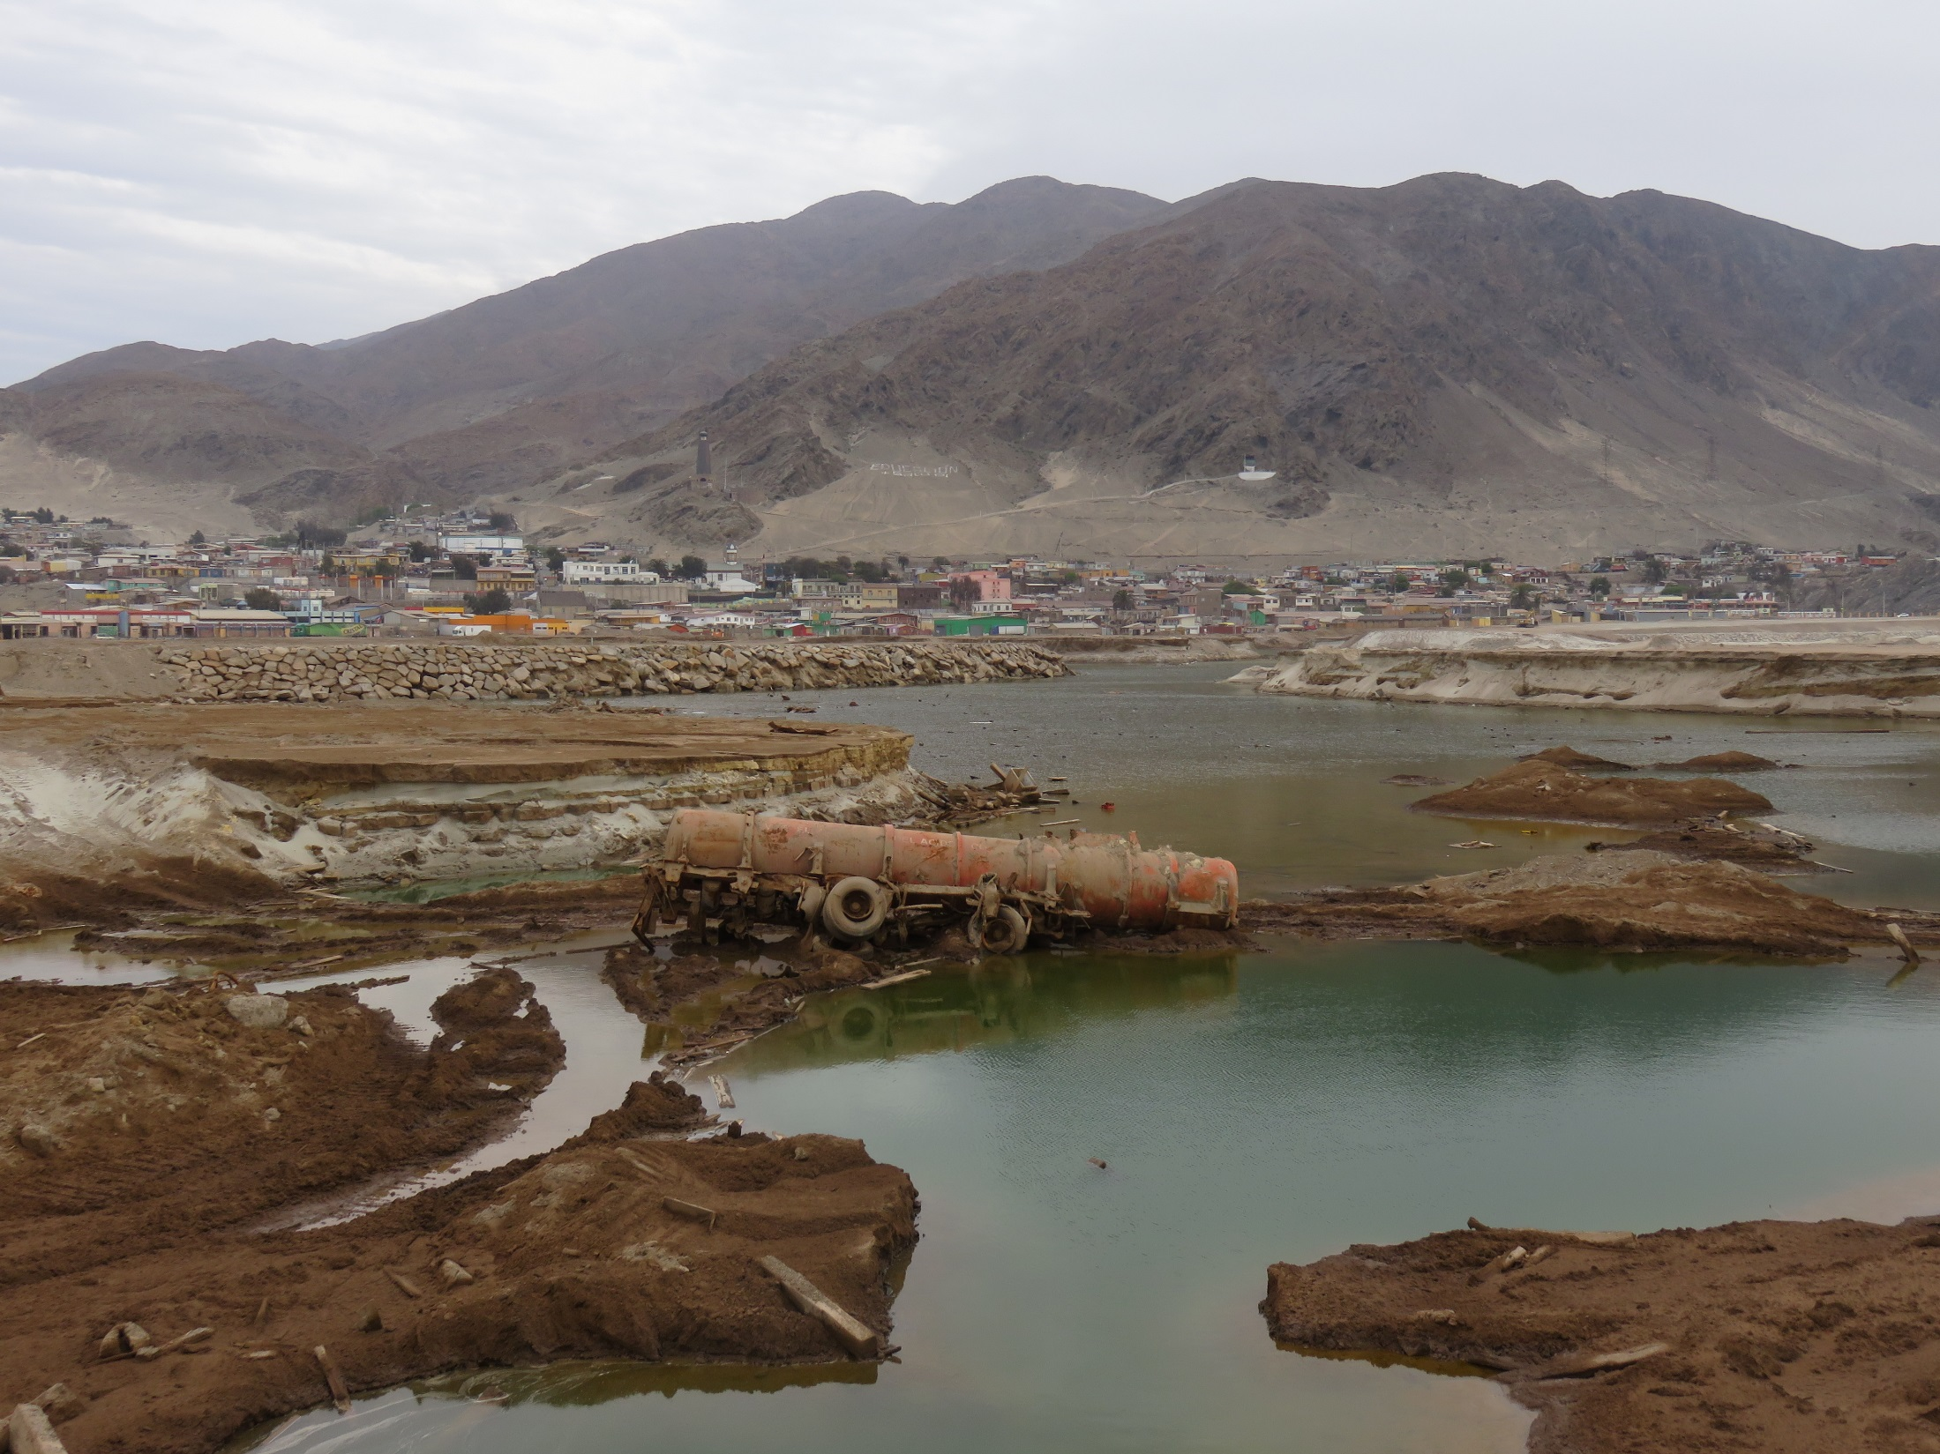
Flooding in Chanaral, 7 months later

Slide 3
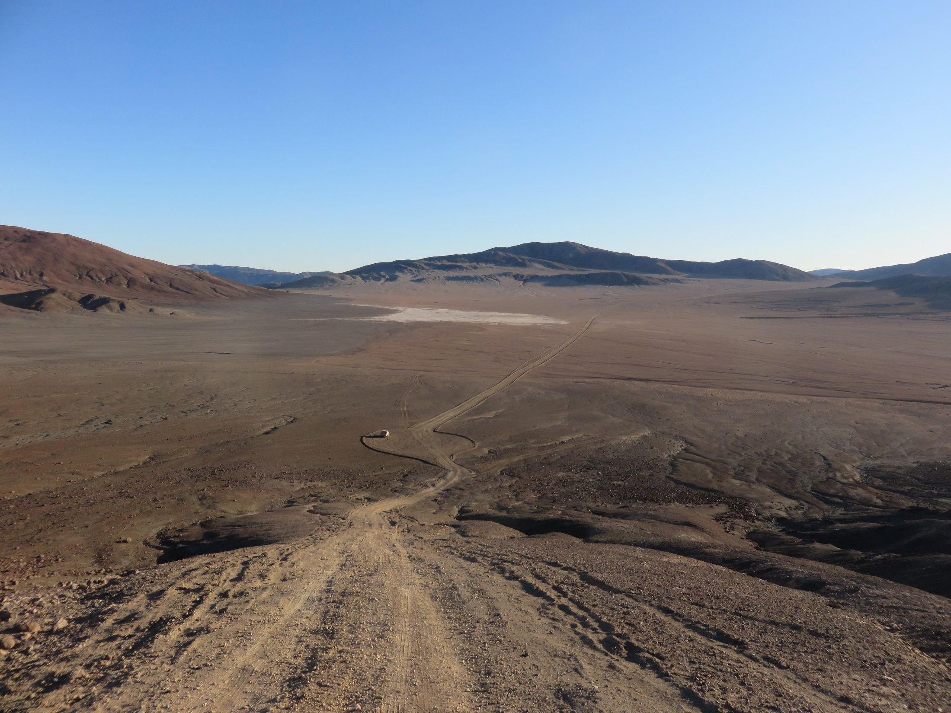
A very quiet night
tent
car

Slide 4
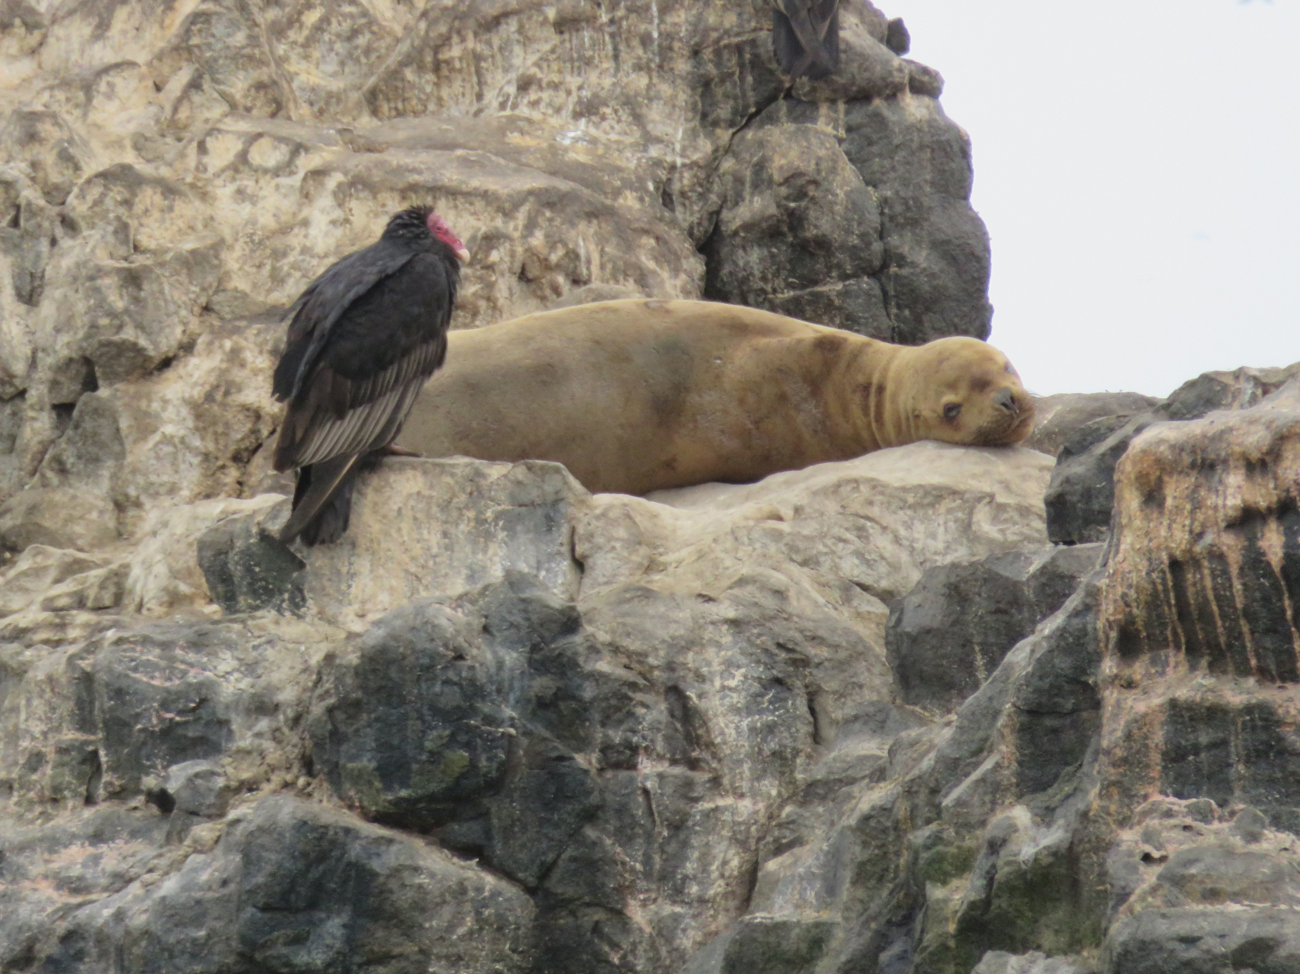
Go away, I’m not dead yet

Slide 5
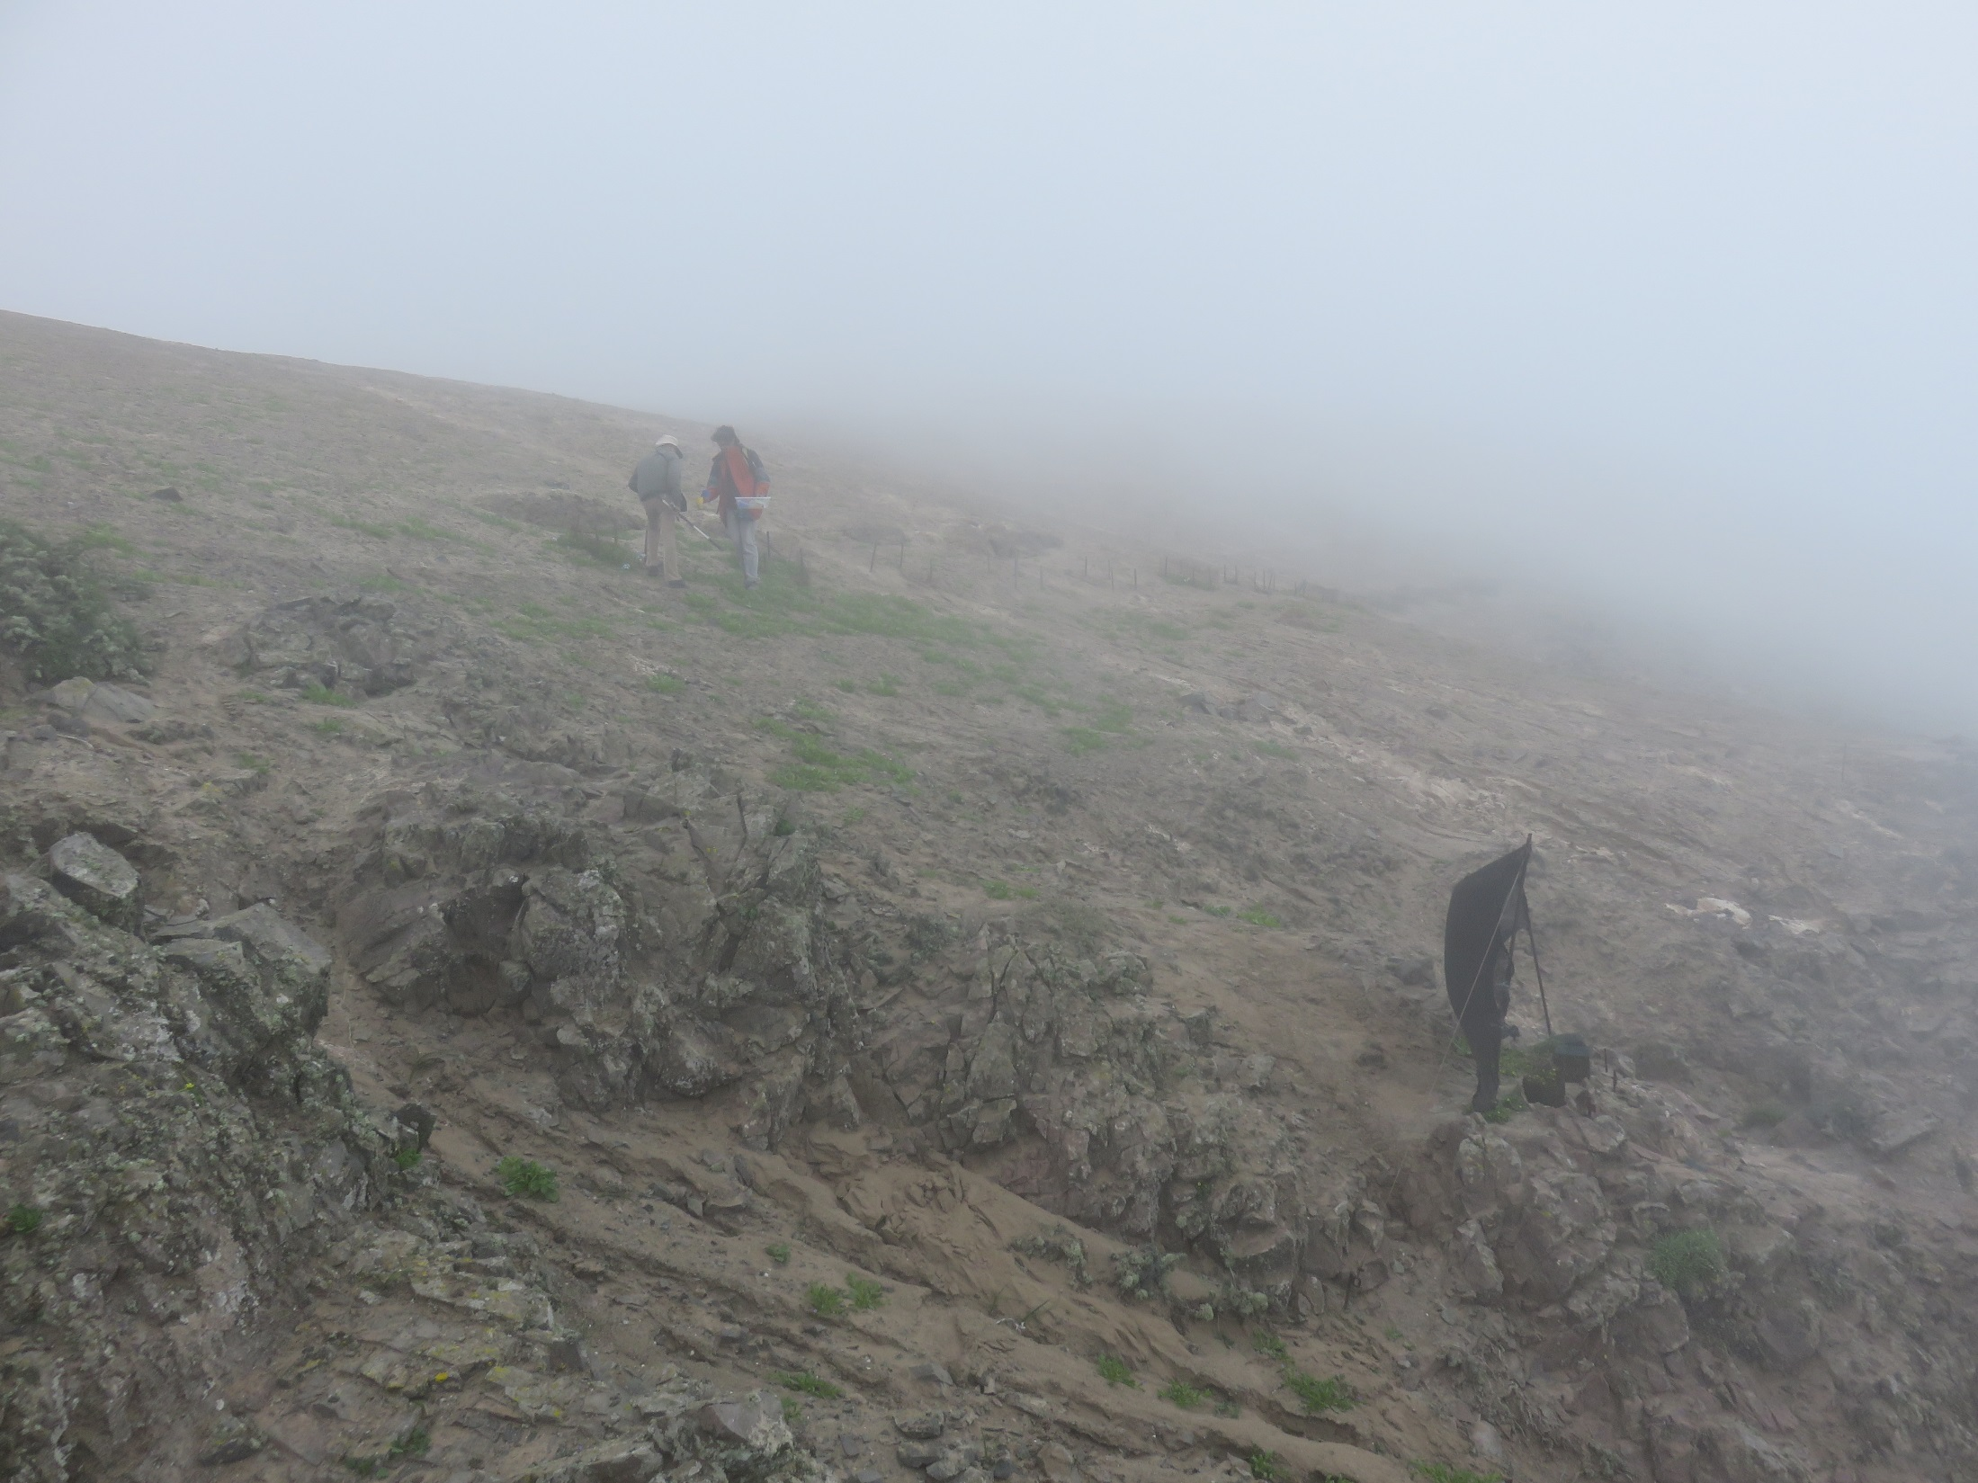
Gale force fog at Alto Patache

Slide 6
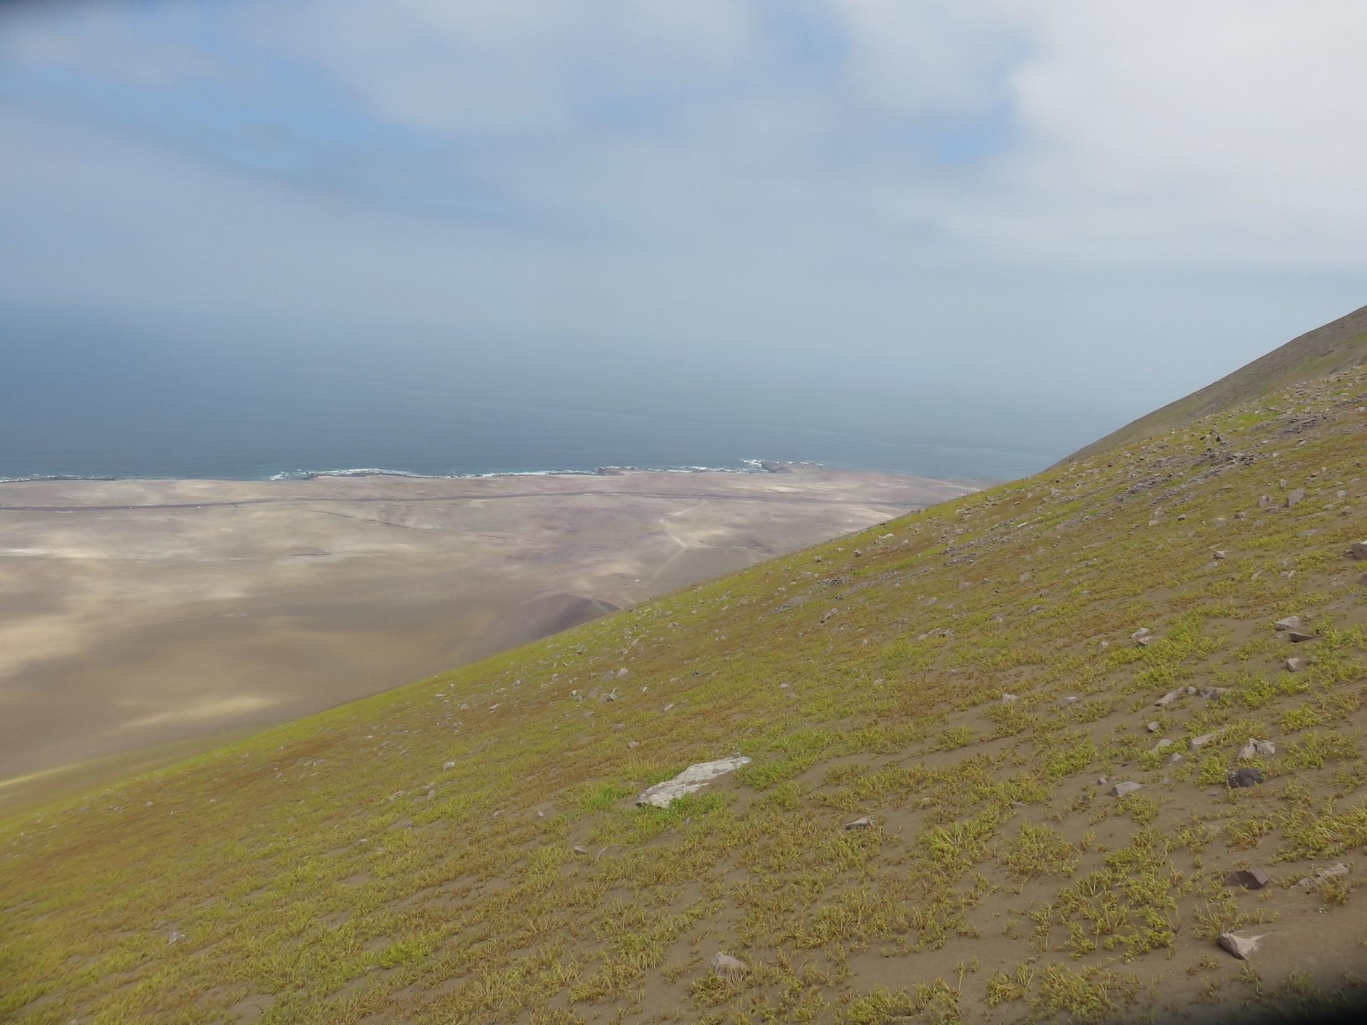
Green for the first time in at least 35 years:
It took me 5 hours to climb up here and I caught a grand total of 3 bees!
Car is tiny white spot here

Slide 7
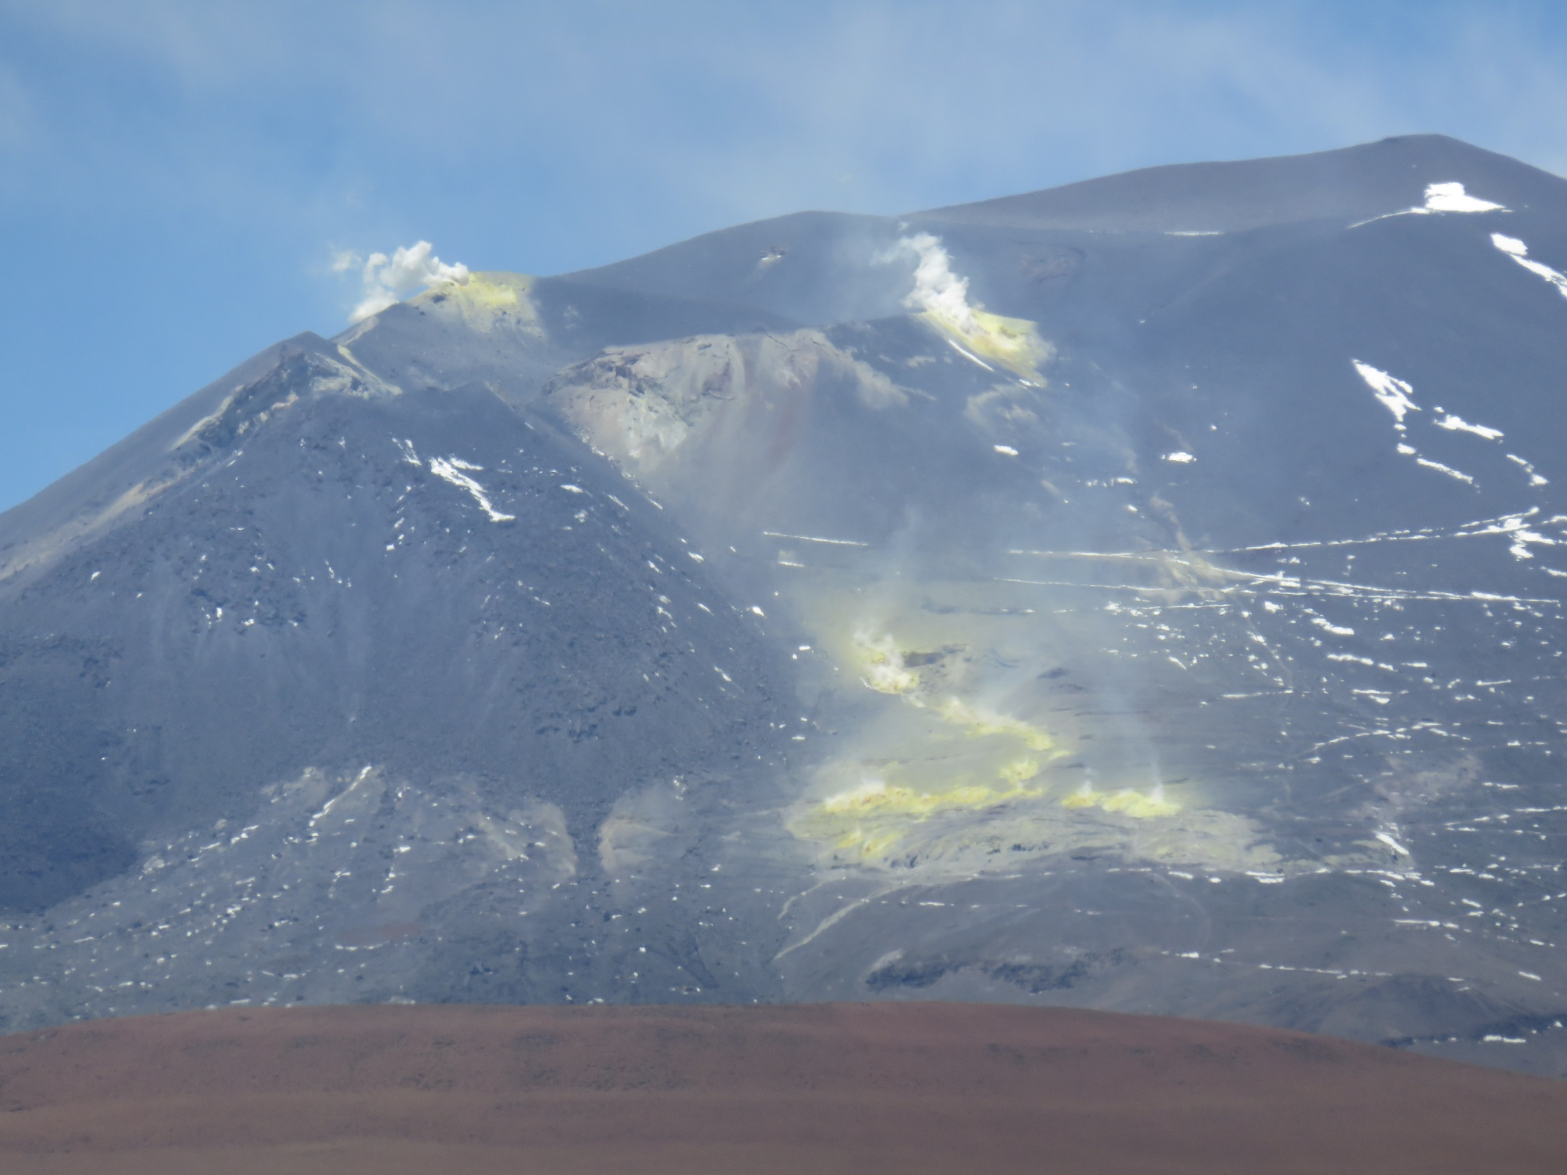
Sinners go here

Slide 8
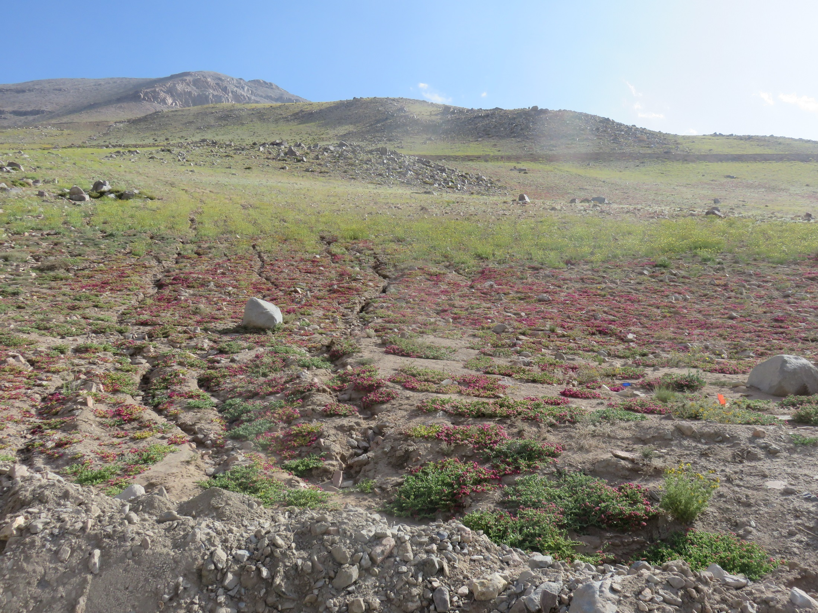
High altitude desert in bloom – not as spectacular as the crimson carpets in the media, but less common. Red in foreground is Cistanthe, yellow in background is mostly a yellow form of a Calandrinia species – the same genus that forms the crimson carpets at lower altitudes – but in some species the colour is a polymorphism with orange heterozygotes.

